Slide 1
WOMEN’S POLITICAL PARTICIPATION AND LEADERSHIP ASSESSMENT: CÔTE D’IVOIRE
Findings Presentation
Date: 2023

Slide 2
AGENDA
-Assessment Purpose & Approach
-Methodology
-Barriers & Opportunities
-Recommendations

Slide 3
ASSESSMENT PURPOSE & APPROACH
The study of women’s political leadership in Côte d’Ivoire investigated the barriers to and opportunities for expanding women’s participation and leadership in the political landscape.
It used the Women’s Political Participation and Leadership (WPPL) Assessment Framework to document women’s access to and power in politics along sociocultural, institutional, and individual dimensions.
The assessment analyzed WPPL through the lenses of access and power.
USAID can use the report’s findings to identify priority areas in which its investments are likely to have the greatest impact.
Notes:
Provide brief background on the framework – highlighting what audience needs to know to follow presentation. Can abbreviate further if audience is assumed to be familiar.

Slide 4
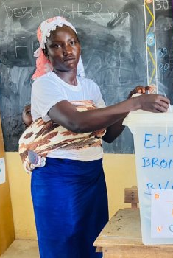
METHODOLOGY
Desk Review
Key Informant Interviews
Five politicians (two women, three men)
Two political leaders (one woman, one man)
Three donors and implementing partners (one woman, two men)
Three WPPL experts (two women, one man)
Six women civil society and media representatives
One man religious leader
A young woman voting in the 2023 local elections (USAID/Côte d’Ivoire).
Notes:
Details include geographic coverage, number of surveyed politicians, number and type of KIIs, number and type of FGDs.

Slide 5
METHODOLOGY—FOCUS GROUP DISCUSSIONS
LOCATION | GROUP DESCRIPTION | NO. OF FGDS
Abidjan | Women in Political Parties and Locally Elected Women (RHDP) Women in Political Parties and Locally Elected Women (PPA-CI) Women in Political Parties and Locally Elected Women (PDCI-RDA) Men in Political Parties and Locally Elected Men (RHDP) Men in Political Parties and Locally Elected Men (PPA-CI) Men in Political Parties and Locally Elected Men (PDCI-RDA) Women Media Workers Men Media Workers Women in Civil Society Men in Civil Society USAID and Embassy | 11
Bouaké | Women in Civil Society Men in Civil Society | 2
Man | Women in Civil Society (2) Men in Civil Society (2) | 4
Korhogo | Women in Civil Society (2) Women in Political Parties and Locally Elected Men in Civil Society | 4
Abengourou | Women in Civil Society (2) Men in Civil Society (2) Media Worker | 5
Gagnoa | Men in Civil Society Women in Civil Society Media Worker | 3

Slide 6
METHODOLOGY—SURVEY
POLITICAL PARTY | NO. OF SURVEYS
RHDP | 10 women politicians 10 men politicians
PDCI | 10 women politicians 10 men politicians
PPA-CI | 10 women politicians 10 men politicians

Slide 7
BARRIERS & OPPORTUNITIES

Slide 8
SOCIOCULTURAL FACTORS
Barriers
Patriarchal norms and attitudes
Sociocultural norms
Marital status
Intimidation, threats, and violence
"Men are still in the past; they want us to be traditional, whereas the world has moved on...that's why, for several years now, they've been doing everything they can to prevent me from being section secretary for my party in this village.’’
(Focus group discussion with women in civil society)

Slide 9
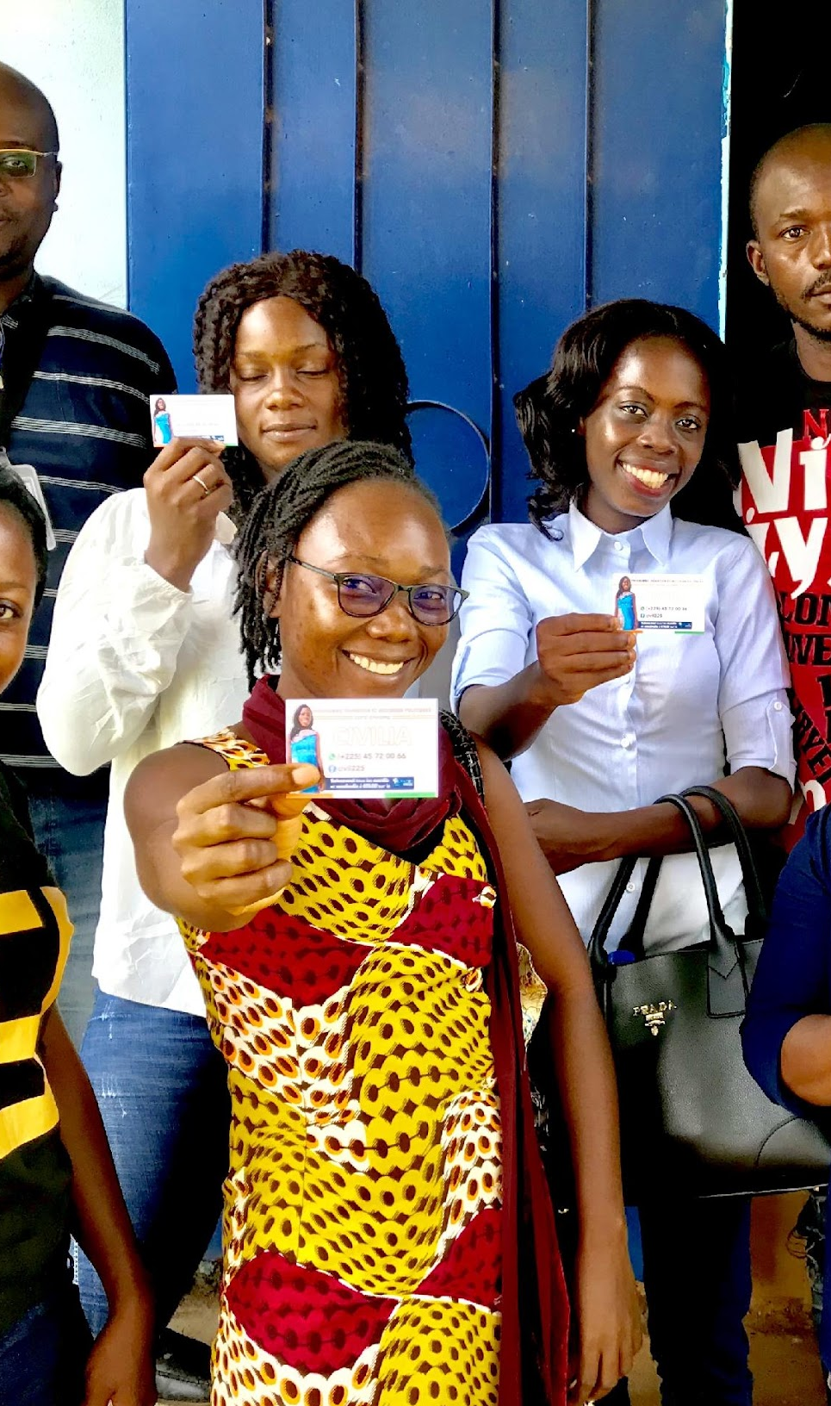
INSTITUTIONAL FACTORS
Barriers
Enforcement capacity and legislation
Logistical barriers
Violence in political parties
Candidate selection processes
Parties’ support for women candidates
Parties’ efforts to advance WPPL
Opportunities
Quota law
Laws on violence against women
Group of youth who were working to combat hate speech (USAID/Côte d’Ivoire).

Slide 10
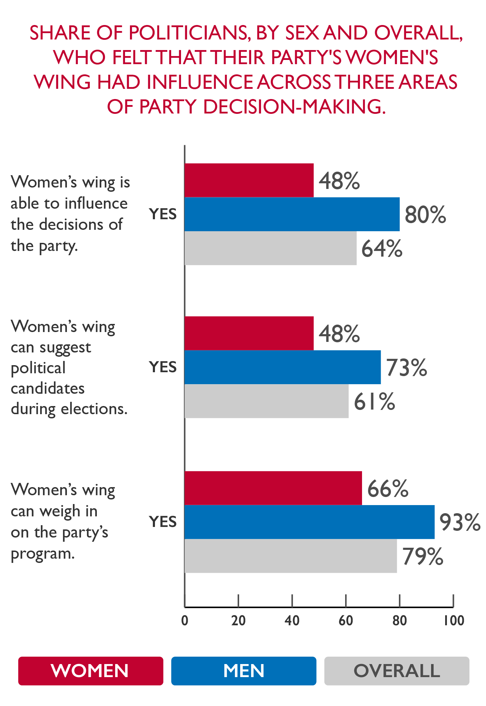
INDIVIDUAL FACTORS
Barriers
Confidence and political awareness
Political violence
Educational attainment and training
Personal financial means
Domestic responsibilities

Slide 11
SELECTED RECOMMENDATIONS

Slide 12
SOCIOCULTURAL
Gender transformative education programs
Mobilize influential men and women
Cultivate a culture of equality
Women leaders as role models
Address sociocultural factors
“There are women who fight. There are women who are ready for anything. With their limited means, they’re ready to go meet with the population because they have a chance to convince electors and see the work they’ve done. And these people then won’t hesitate to go out and vote. Yes, we have seen cases like that. Women who started from nothing, who had only a primary school education, but who became members of parliament, beating doctors and academics.” (Focus group discussion with women in civil society, Bouaké)

Slide 13
INSTITUTIONAL
Strengthen the CEI gender unit
Reduce logistical barriers
Women’s involvement in local-level decision-making
Enforce the 2019 gender quota law
Complementary gender quota law
Legislation to address political violence
Women’s leadership in party structures
Improve data and reporting

Slide 14
INDIVIDUAL
Foster solidarity
Women’s civic education
Literacy and education for girls and women
Women’s earnings and wealth equality
Capacity of women candidates
Mentorship program for women political candidates

Slide 15
QUESTIONS?

